Slide 1

Unit 4 : Types of machine learning
Lecture 3: Classification and its types
School of Computer Science UPES, Dehradun
India

Slide 2
Table of Contents
Classification: Basic Concepts
Decision Tree Induction
Bayes Classification Methods
Rule-Based Classification
Logistic Regression

Slide 3
Learning & Course Outcomes
LO1: To understand the fundamental principles and objectives of classification.
LO2: To apply decision tree induction, Bayes methods, rule-based systems, SVMs, random forests, and logistic regression for classification tasks.
LO3: To analyze the decision-making processes of different classifiers.
CO2: Understand the basics of Machine Learning and its types.

Slide 4
Supervised vs. Unsupervised Learning
Supervised learning (regression and classification)
Supervision: The training data (observations, measurements, etc.) are accompanied by labels indicating the class of the observations
New data is classified based on the training set
Unsupervised learning (clustering)
The class labels of training data is unknown
Given a set of measurements, observations, etc. with the aim of establishing the existence of classes or clusters in the data

Slide 5
Prediction Problems: Classification vs. Numeric Prediction
Classification
predicts categorical class labels (discrete or nominal)
classifies data (constructs a model) based on the training set and the values (class labels) in a classifying attribute and uses it in classifying new data
Numeric Prediction
models continuous-valued functions, i.e., predicts unknown or missing values
Typical applications
Credit/loan approval:
Medical diagnosis: if a tumor is cancerous or benign
Fraud detection: if a transaction is fraudulent
Web page categorization: which category it is

Slide 6
Classification—A Two-Step Process
Model construction: describing a set of predetermined classes
Each tuple/sample is assumed to belong to a predefined class, as determined by the class label attribute
The set of tuples used for model construction is training set
The model is represented as classification rules, decision trees, or mathematical formulae
Model usage: for classifying future or unknown objects
Estimate accuracy of the model
The known label of test sample is compared with the classified result from the model
Accuracy rate is the percentage of test set samples that are correctly classified by the model
Test set is independent of training set (otherwise overfitting)
If the accuracy is acceptable, use the model to classify new data
Note: If the test set is used to select models, it is called validation (test) set

Slide 7
Process (1): Model Construction
Classification
Algorithms
Training
Data
Classifier
(Model)
IF rank = ‘professor’
OR years > 6
THEN tenured = ‘yes’

Slide 8
Process (2): Using the Model in Prediction
Classifier
Testing
Data
Unseen Data
(Jeff, Professor, 4)
Tenured?

Slide 9
Decision Tree Induction: An Example
Training data set: Buys_computer
The data set follows an example of Quinlan’s ID3 (Playing Tennis)

Slide 10
Decision Tree Induction: An Example
Resulting tree:
age?
<=30
overcast
>40
31..40
student?
yes
credit rating?
no
yes
excellent
fair
no
yes
no
yes

Slide 11
Algorithm for Decision Tree Induction
Basic algorithm (a greedy algorithm)
Tree is constructed in a top-down recursive divide-and-conquer manner
At start, all the training examples are at the root
Attributes are categorical (if continuous-valued, they are discretized in advance)
Examples are partitioned recursively based on selected attributes
Test attributes are selected on the basis of a heuristic or statistical measure (e.g., information gain)
Conditions for stopping partitioning
All samples for a given node belong to the same class
There are no remaining attributes for further partitioning – majority voting is employed for classifying the leaf
There are no samples left

Slide 12
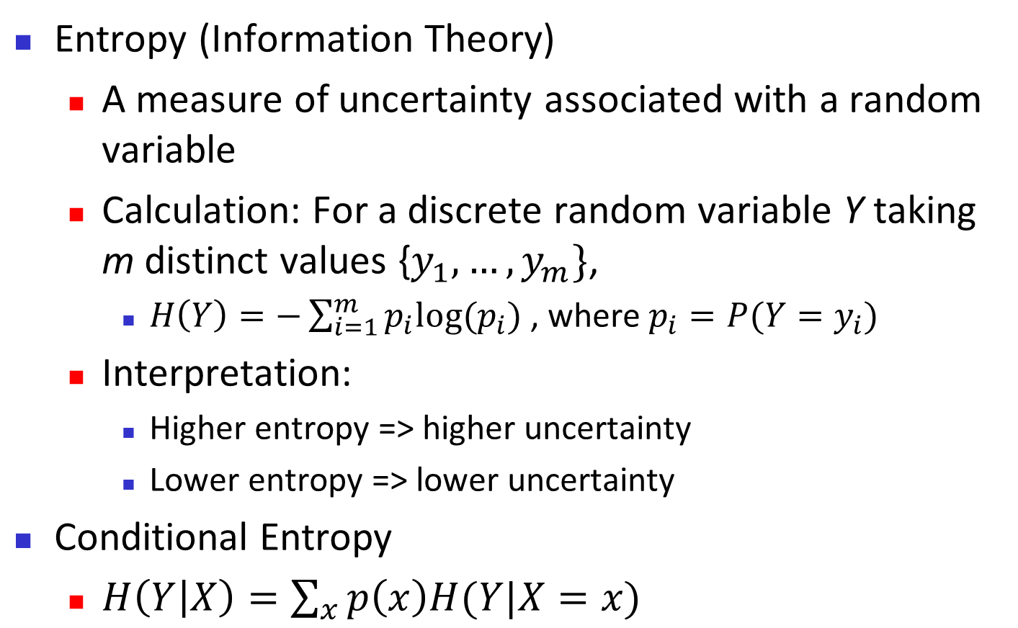
Brief Review of Entropy

Slide 13
Attribute Selection Measure: Information Gain (ID3/C4.5)
Select the attribute with the highest information gain
Let p_{i} be the probability that an arbitrary tuple in D belongs to class C_{i}, estimated by |C_{i, D}|/|D|
Expected information (entropy) needed to classify a tuple in D:
Information needed (after using A to split D into v partitions) to classify D:
Information gained by branching on attribute A

Slide 14
Attribute Selection: Information Gain
Class P: buys_computer = “yes”
Class N: buys_computer = “no”
means “age <=30” has 5 out of 14 samples, with 2 yes’es and 3 no’s. Hence
Similarly,

Slide 15
Bayesian Classification: Why?
A statistical classifier: performs probabilistic prediction, i.e., predicts class membership probabilities
Foundation: Based on Bayes’ Theorem.
Performance: A simple Bayesian classifier, naïve Bayesian classifier, has comparable performance with decision tree and selected neural network classifiers
Incremental: Each training example can incrementally increase/decrease the probability that a hypothesis is correct — prior knowledge can be combined with observed data
Standard: Even when Bayesian methods are computationally intractable, they can provide a standard of optimal decision making against which other methods can be measured

Slide 16
Bayes’ Theorem: Basics
Total probability Theorem:
Bayes’ Theorem:
Let X be a data sample (“evidence”): class label is unknown
Let H be a hypothesis that X belongs to class C
Classification is to determine P(H|X), (i.e., posteriori probability): the probability that the hypothesis holds given the observed data sample X
P(H) (prior probability): the initial probability
E.g., X will buy computer, regardless of age, income, …
P(X): probability that sample data is observed
P(X|H) (likelihood): the probability of observing the sample X, given that the hypothesis holds
E.g., Given that X will buy computer, the prob. that X is 31..40, medium income

Slide 17
Prediction Based on Bayes’ Theorem
Given training data X, posteriori probability of a hypothesis H, P(H|X), follows the Bayes’ theorem
Informally, this can be viewed as
posteriori = likelihood x prior/evidence
Predicts X belongs to C_{i} iff the probability P(C_{i}|X) is the highest among all the P(C_{k}|X) for all the k classes
Practical difficulty: It requires initial knowledge of many probabilities, involving significant computational cost

Slide 18
Classification Is to Derive the Maximum Posteriori
Let D be a training set of tuples and their associated class labels, and each tuple is represented by an n-D attribute vector X = (x₁, x₂, …, x_{n})
Suppose there are m classes C₁, C₂, …, C_{m}.
Classification is to derive the maximum posteriori, i.e., the maximal P(C_{i}|X)
This can be derived from Bayes’ theorem
Since P(X) is constant for all classes, only
needs to be maximized

Slide 19
Naïve Bayes Classifier: Training Dataset
Class:
C1:buys_computer = ‘yes’
C2:buys_computer = ‘no’
Data to be classified:
X = (age <=30,
Income = medium,
Student = yes
Credit_rating = Fair)

Slide 20
Naïve Bayes Classifier: An Example
P(C_{i}): P(buys_computer = “yes”) = 9/14 = 0.643
P(buys_computer = “no”) = 5/14= 0.357
Compute P(X|C_{i}) for each class
P(age = “<=30” | buys_computer = “yes”) = 2/9 = 0.222
P(age = “<= 30” | buys_computer = “no”) = 3/5 = 0.6
P(income = “medium” | buys_computer = “yes”) = 4/9 = 0.444
P(income = “medium” | buys_computer = “no”) = 2/5 = 0.4
P(student = “yes” | buys_computer = “yes) = 6/9 = 0.667
P(student = “yes” | buys_computer = “no”) = 1/5 = 0.2
P(credit_rating = “fair” | buys_computer = “yes”) = 6/9 = 0.667
P(credit_rating = “fair” | buys_computer = “no”) = 2/5 = 0.4
X = (age <= 30 , income = medium, student = yes, credit_rating = fair)
P(X|C_{i}) : P(X|buys_computer = “yes”) = 0.222 x 0.444 x 0.667 x 0.667 = 0.044
P(X|buys_computer = “no”) = 0.6 x 0.4 x 0.2 x 0.4 = 0.019
P(X|C_{i})*P(C_{i}) : P(X|buys_computer = “yes”) * P(buys_computer = “yes”) = 0.028
P(X|buys_computer = “no”) * P(buys_computer = “no”) = 0.007
Therefore, X belongs to class (“buys_computer = yes”)

Slide 21
Naïve Bayes Classifier: Comments
Advantages
Easy to implement
Good results obtained in most of the cases
Disadvantages
Assumption: class conditional independence, therefore loss of accuracy
Practically, dependencies exist among variables
E.g., hospitals: patients: Profile: age, family history, etc.
Symptoms: fever, cough etc., Disease: lung cancer, diabetes, etc.
Dependencies among these cannot be modeled by Naïve Bayes Classifier

Slide 22
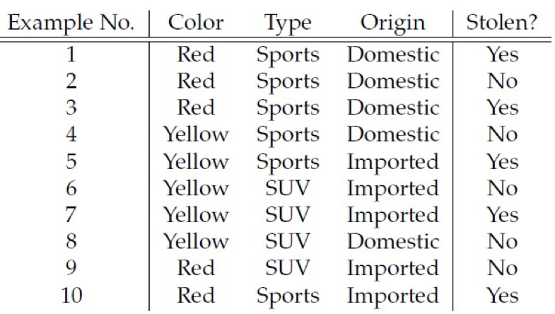
Practice Question
Classify the tuple X= {Color=”RED”, Type= “SUV”, Origin=”Domestic”} using Naïve Bayesian classification. Training data is given in the following table where class label is STOLEN.

Slide 23
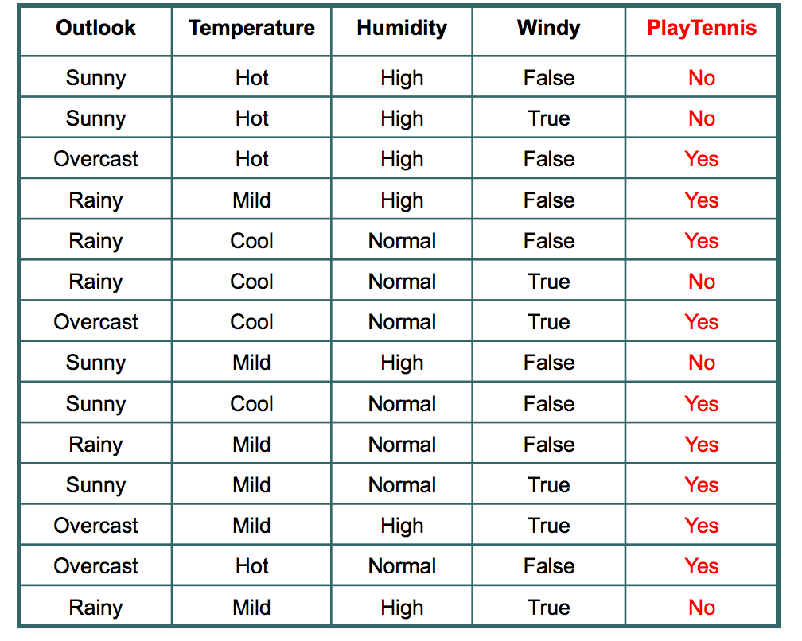
Practice Question
Classify sample X= {rainy, hot, high, false} ”} using Naïve Bayesian classification. Training data is given in the following table

Slide 24
Using IF-THEN Rules for Classification
Represent the knowledge in the form of IF-THEN rules
R: IF age = youth AND student = yes THEN buys_computer = yes
Rule antecedent/precondition vs. rule consequent
Assessment of a rule: coverage and accuracy
n_{covers} = # of tuples covered by R
n_{correct} = # of tuples correctly classified by R
coverage(R) = n_{covers} /|D| /* D: training data set */
accuracy(R) = n_{correct} / n_{covers}
If more than one rule are triggered, need conflict resolution
Size ordering: assign the highest priority to the triggering rules that has the “toughest” requirement (i.e., with the most attribute tests)
Class-based ordering: decreasing order of prevalence or misclassification cost per class
Rule-based ordering (decision list): rules are organized into one long priority list, according to some measure of rule quality or by experts

Slide 25
Rule Extraction from a Decision Tree
Rules are easier to understand than large trees
One rule is created for each path from the root to a leaf
Each attribute-value pair along a path forms a conjunction: the leaf holds the class prediction
Rules are mutually exclusive and exhaustive
age?
<=30
31..40
>40
student?
credit rating?
yes
no
yes
excellent
fair
no
yes
no
yes
Example: Rule extraction from our buys_computer decision-tree
IF age = young AND student = no THEN buys_computer = no
IF age = young AND student = yes THEN buys_computer = yes
IF age = mid-age THEN buys_computer = yes
IF age = old AND credit_rating = excellent THEN buys_computer = no
IF age = old AND credit_rating = fair THEN buys_computer = yes

Slide 26
Logistic Regression
Logistic regression is a supervised machine learning algorithm used for classification tasks where the goal is to predict the probability that an instance belongs to a given class or not.
Logistic regression predicts the output of a categorical dependent variable. Therefore, the outcome must be a categorical or discrete value.
It can be either Yes or No, 0 or 1, true or False, etc. but instead of giving the exact value as 0 and 1, it gives the probabilistic values which lie between 0 and 1.
In Logistic regression, instead of fitting a regression line, we fit an “S” shaped logistic function, which predicts two maximum values (0 or 1).

Slide 27
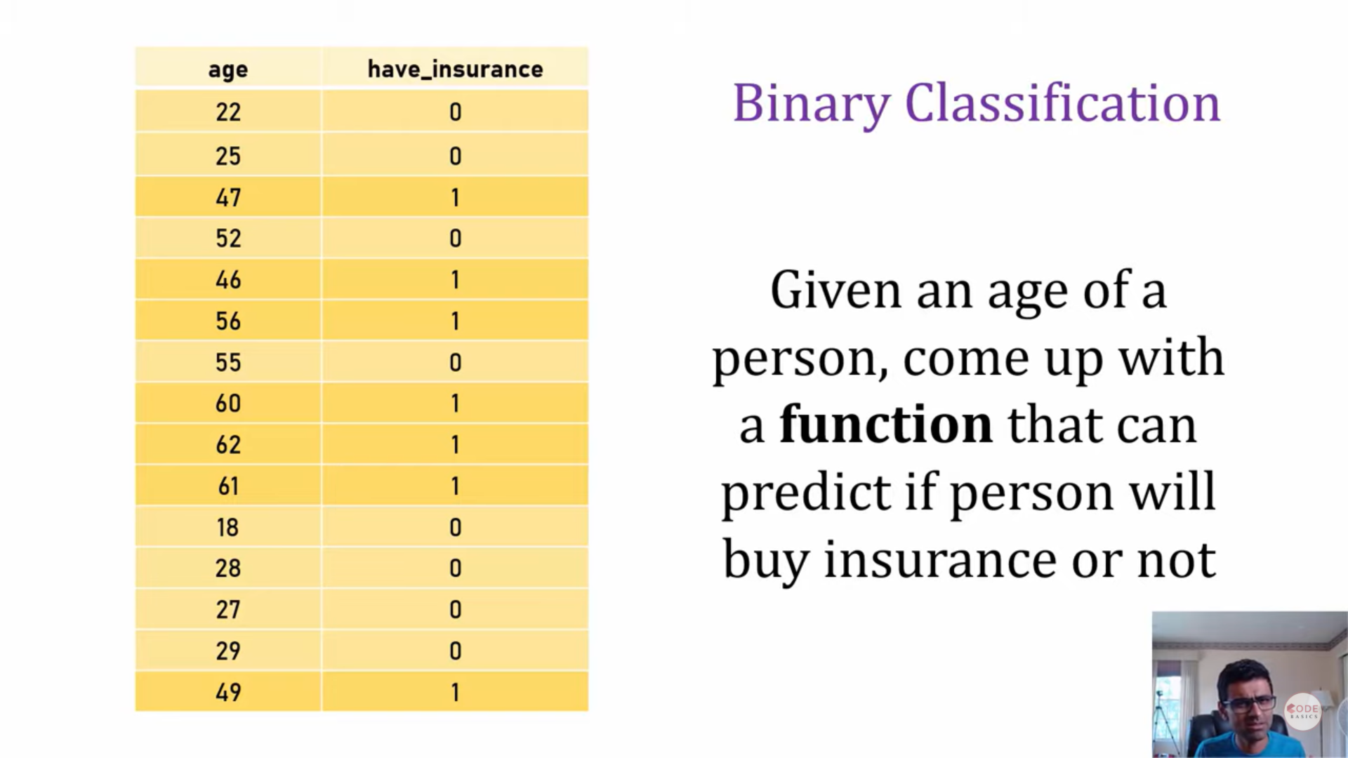
Logistic Regression

Slide 28
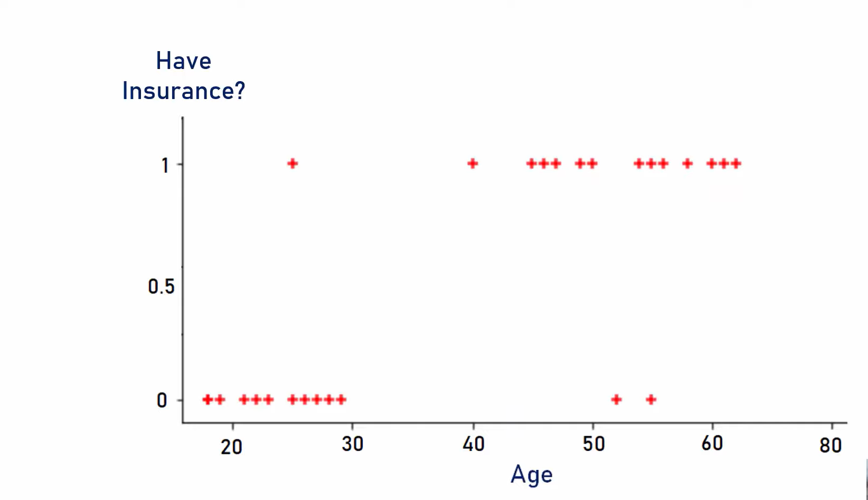
Logistic Regression

Slide 29
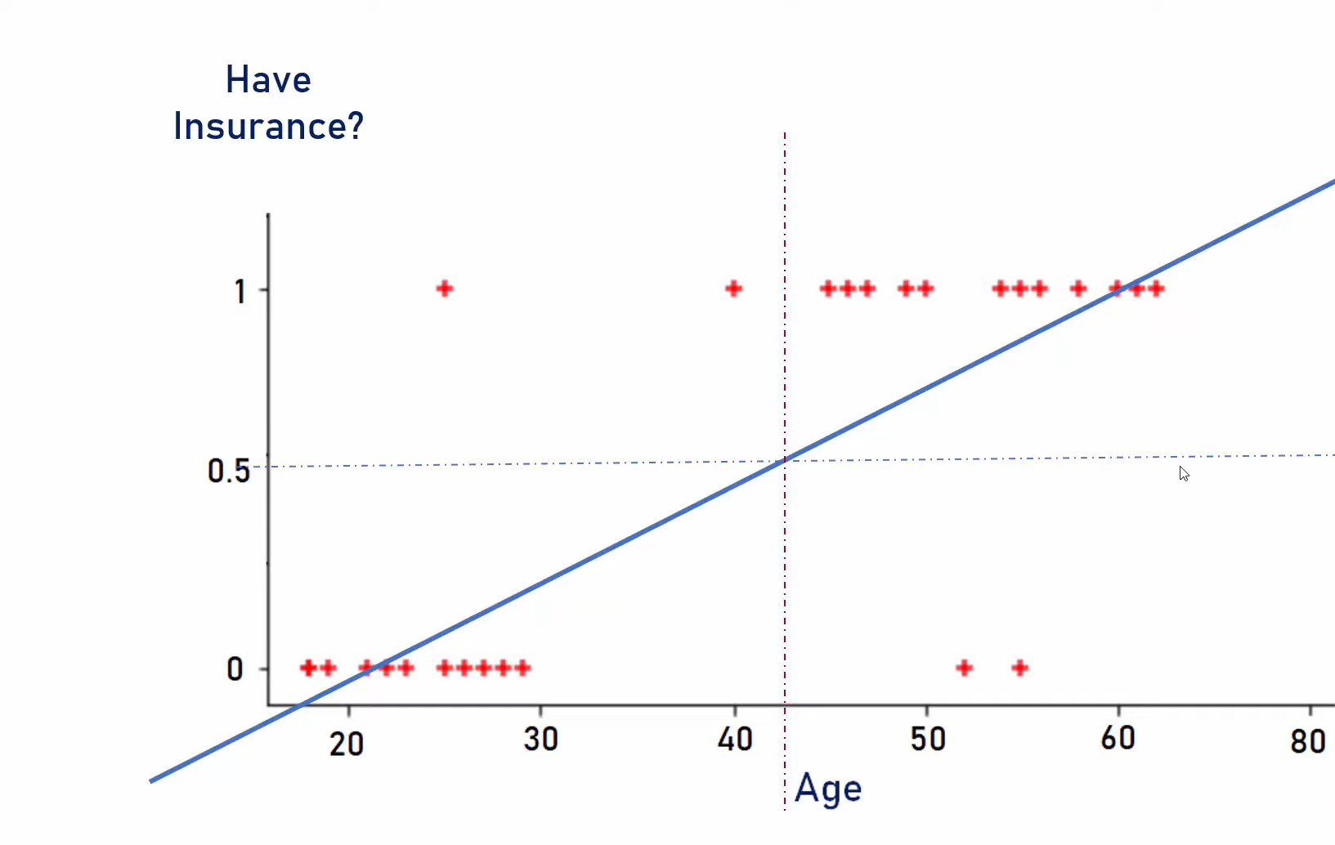
Logistic Regression

Slide 30
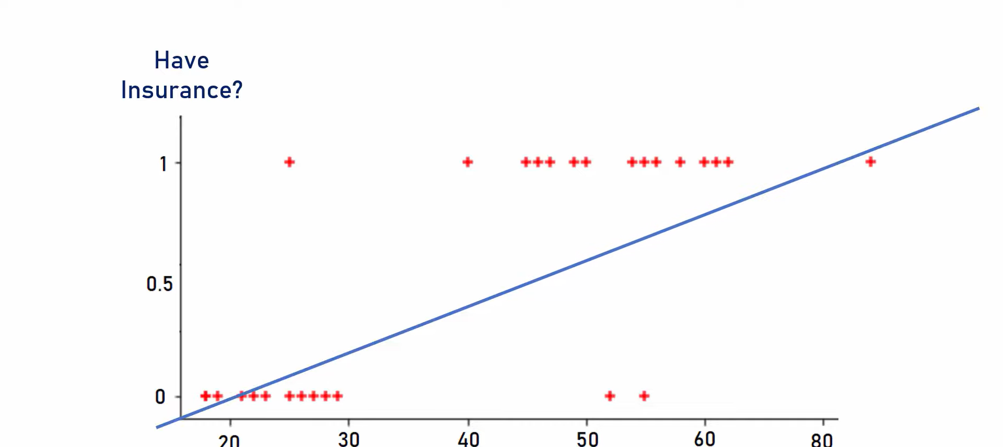
Logistic Regression

Slide 31
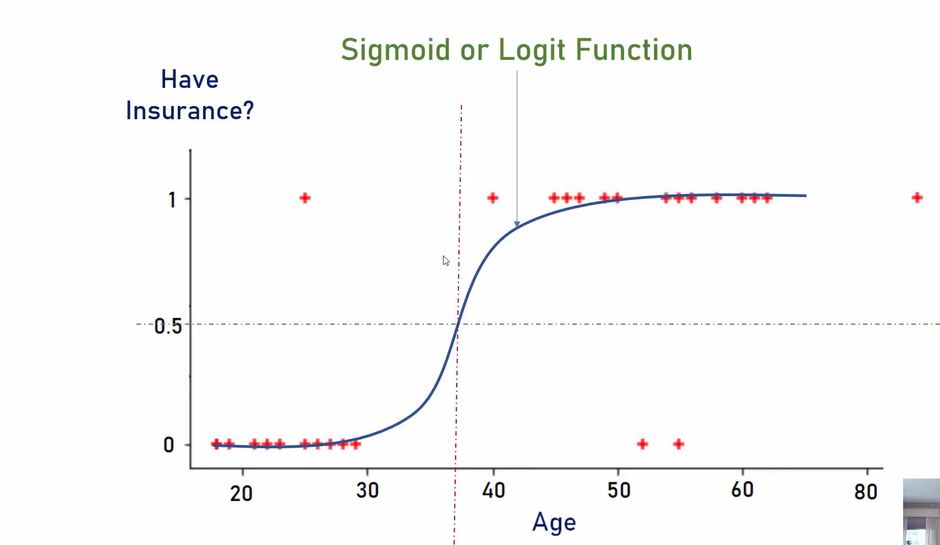
Sigmoid Function

Slide 32
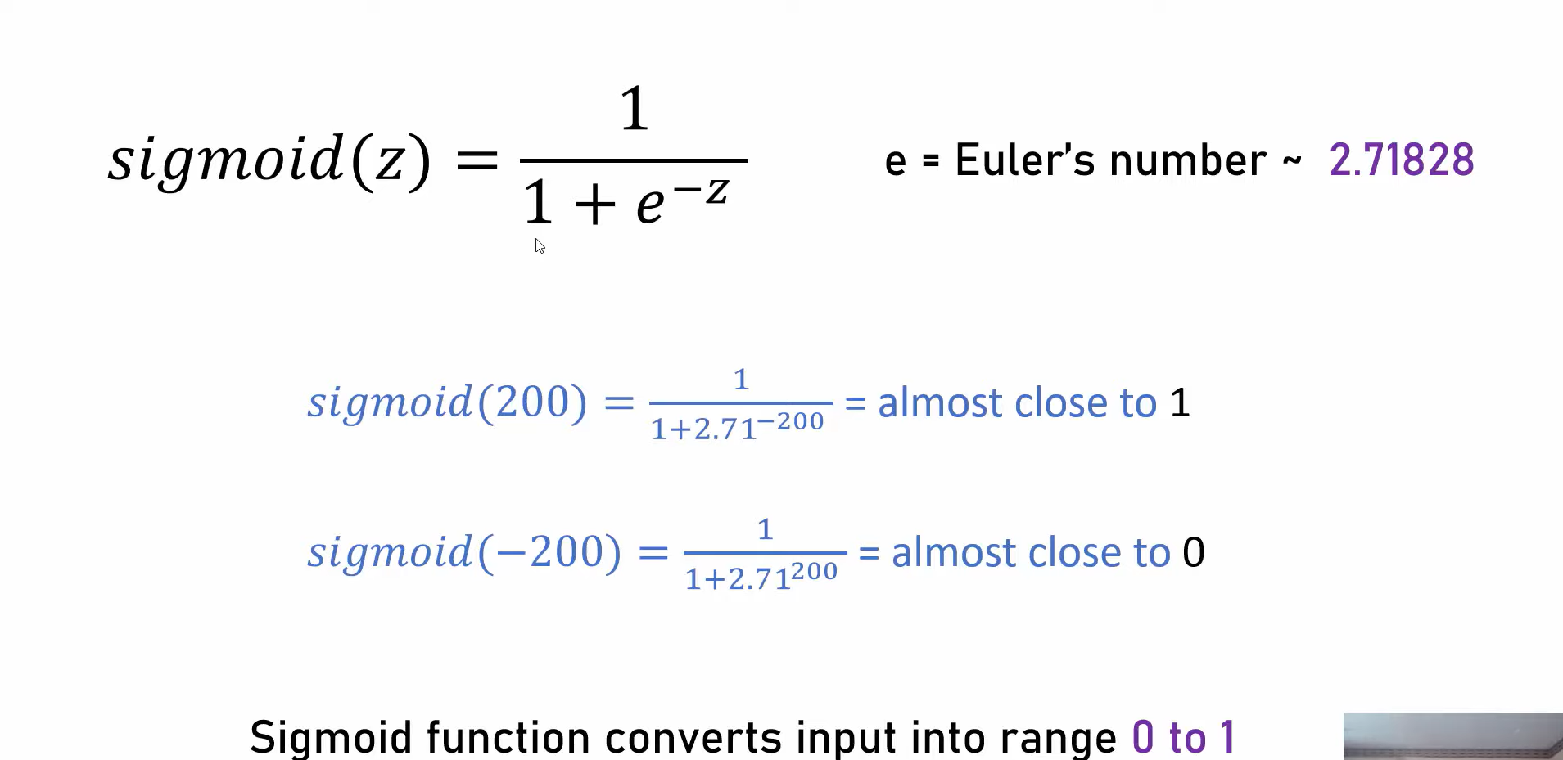
Sigmoid Function

Slide 33
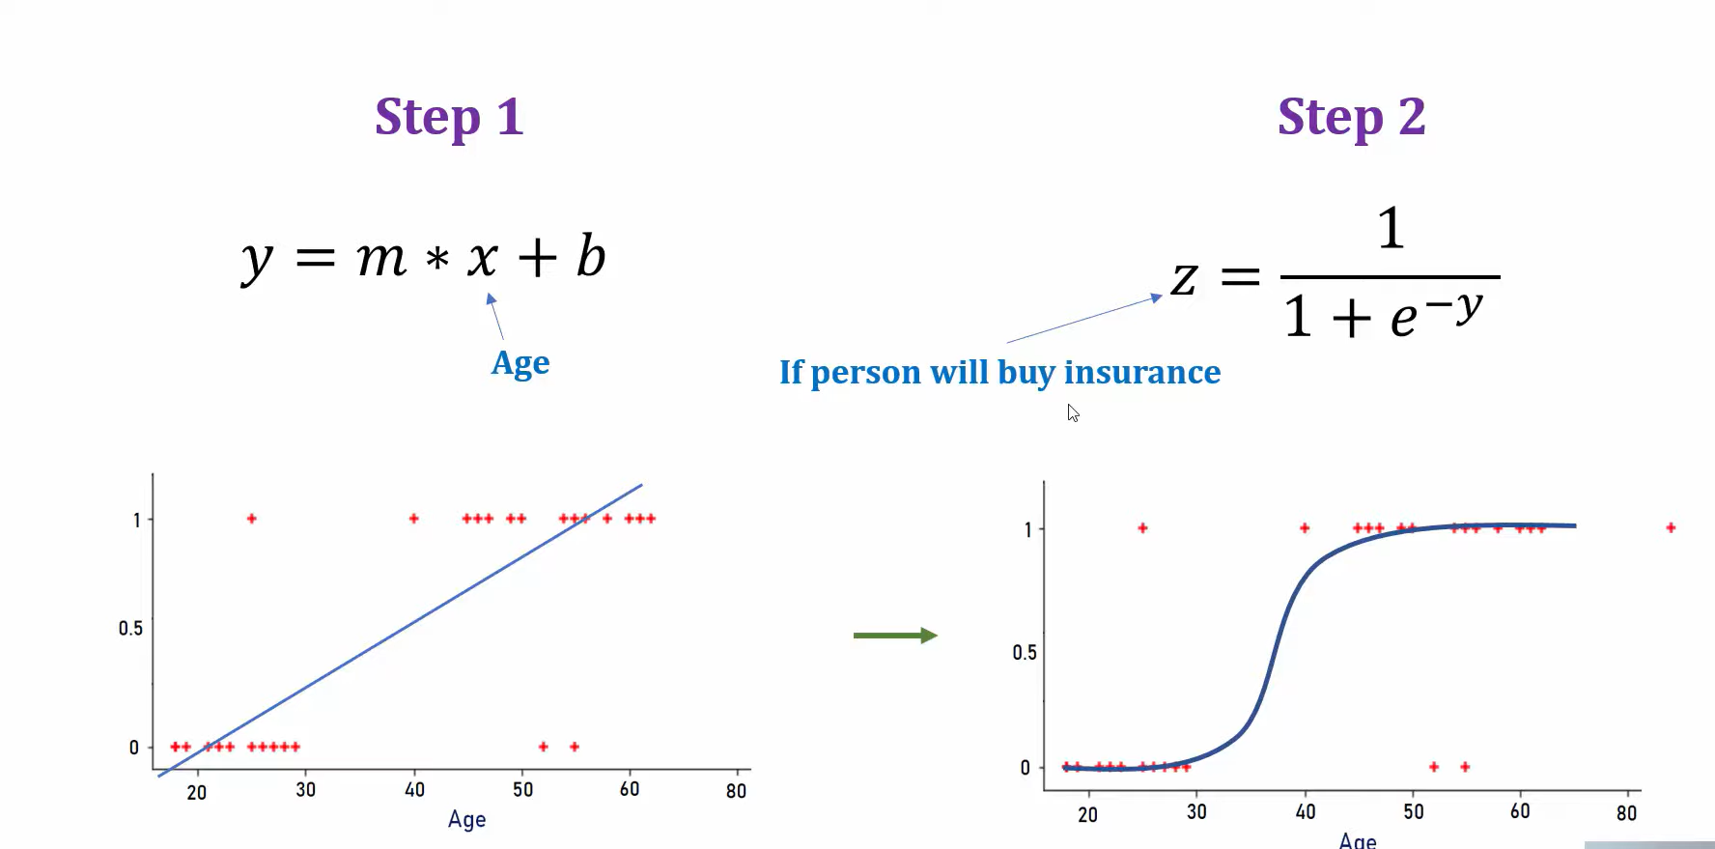
Sigmoid Function

Slide 34
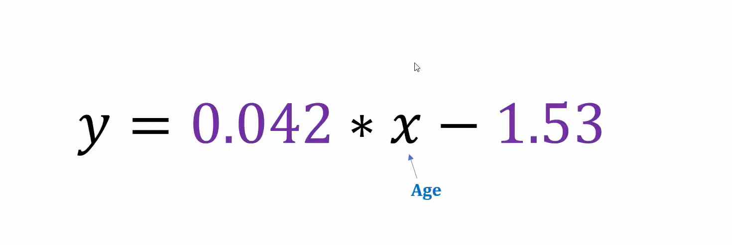
Sigmoid Function

Slide 35
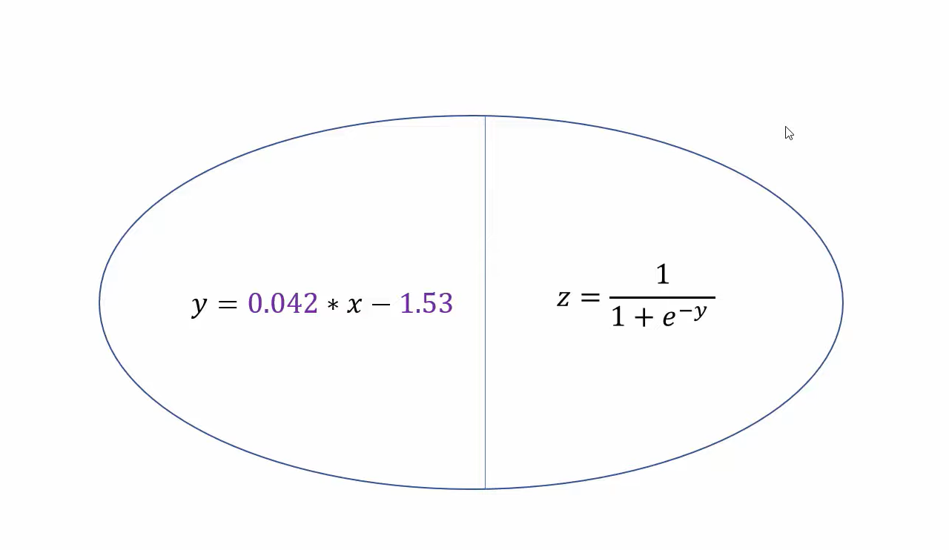
Sigmoid Function

Slide 36
Summary
Definition: Classification is a supervised learning technique used to predict the categorical label of new observations based on past observations.
Key Algorithms:
Logistic Regression: Models the probability of a binary outcome.
Decision Trees: Splits data into branches to reach a classification decision.
Support Vector Machines (SVM): Finds the optimal hyperplane to separate classes.
Naive Bayes: Applies Bayes’ theorem with the assumption of independence between predictors.
K-Nearest Neighbors (KNN): Classifies based on the majority label of the nearest neighbors.
·Applications:
Spam Detection: Classifying emails as spam or not spam.
Medical Diagnosis: Predicting the presence of a disease.
Sentiment Analysis: Determining the sentiment of a text (e.g., positive or negative).
Image Recognition: Classifying objects within images.

Slide 37
Reference Material
Machine Learning for Dummies, By John Paul Mueller and Luca Massaron, For Dummies, 2016.
NPTEL Lecture: https://www.youtube.com/watch?v=32M5v9jJtJ0&t=2s

Slide 38
MCQ’s
What is the primary goal of classification in machine learning?
a) Predicting continuous outcomes b) Grouping similar data points c) Predicting categorical outcomes d) Reducing the number of features
2. Which of the following algorithms is commonly used for classification?
a) Linear Regression b) K-Means Clustering c) Decision Trees d) Principal Component Analysis
3. Which of the following is an example of a binary classification problem?
a) Predicting the price of a house b) Classifying emails as spam or not spam c) Predicting the temperature for tomorrow d) Grouping customers into segments

Slide 39
MCQ’s
4. Which algorithm is known for using a probabilistic approach to classification?
a) Decision Tree b) Support Vector Machine c) K-Nearest Neighbors d) Naive Bayes
5. Which machine learning technique is specifically used for predicting categorical outcomes?
a) Linear Regression b) Logistic Regression c) Decision Trees d) Principal Component Analysis
6. In logistic regression, how are probabilities estimated for classification?
a) Using a linear equation b) Using a decision tree c) Using a step function d) Using a sigmoid function

Slide 40
MCQ’s Answers
Answers
1. c) Predicting categorical outcomes
2. c) Decision Trees
3. b) Classifying emails as spam or not spam
4. d) Naive Bayes
5. b) Logistic Regression
6. d) Using a sigmoid function

Slide 41
What’s Next
Unsupervised Learning: Clustering

Slide 42

Thank You

